Slide 1
Prof. Subodh Wagle, IIT Bombay
TD 638: Development Perspectives
History of Social, Economy, Political, Technological Systems

Slide 2
History of Social, Economy, Political, Technological Systems

Slide 3
Feudalism (in Europe) . . . 1
Socio-Economic-Political Organization of Society in Europe (and most of the world) before mid-1700s
Most people lived in rural areas,
Social Dimension: In large size families and clans and under social customs/ religious beliefs strictly controlled by the Church
Political Dimension : Repressive political control and regulation by Kings and Overlords
Technological Dimension : Use of primitive tools and technologies for artisanal scale production in small workshops.

Slide 4
Feudalism (in Europe) . . . 2
Socio-Economic-Political Organization of Society in Europe (and most of the world) before the mid-1700s
Economic Dimension: Reliance mainly on subsistence agricultural production as farmers and laborers,
which was heavily taxed by Feudal lords and Kings
Manufacturing: Some people produced manufactured goods
at an artisanal scale in small, house-based workshops,
using primitive tools and technologies.
These were operations of large families.
International trade existed on a comparatively limited scale,
trading niche products such as spices, precious metals, and some luxury goods.

Slide 5
Imperialism, Colonialism, and Mercantilism
Imperialism is a political system in which an imperial state
exercises strong control over territories beyond its initial borders.
This control manifests simultaneously in diverse manners, like colonialism, militarism, cultural hegemony.
Mercantilism is an economic-political system—a form of economic nationalism—that works
to empower a nation by acquiring wealth and resources while increasing its military and political power
by maintaining a favourable trade balance.
Economic Policies: maximizing exports of manufactured goods and imports of raw material
through restrictive trade practices.
Colonialism is an economic-political system in which a colonizing country conquers and rules over other regions.
It involves exploiting the resources and markets of the conquered country for the benefit of the conqueror.

Slide 6
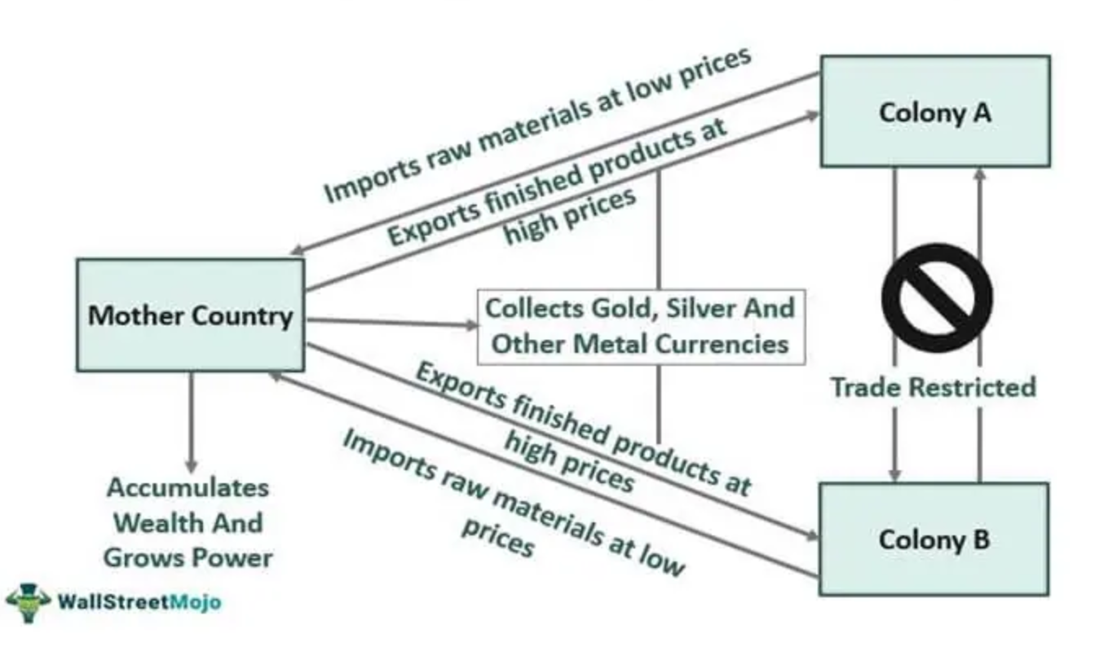
Mercantilism: How it Works?

Slide 7
Capitalism . . 1
Capitalism: A new social organization of production (=how society organized economic activity of production)
Production (manufacturing) was organised in privately owned units, (need not be by members of same family)
whose owners (manufacturers) had capital (=funds/ finance/ money), hence, they were called capitalist
Capitalists used capital to buy the means and materials required for Production (manufacturing)
Labour (One Means of Production): These workers had no other means of making a living,
But to sell their labour power in the (labour) market to Capitalists.
Market: Main mechanism for manufacturers, workers (labour), and consumers (of production)
to sell what they had to offer (for sale)
and to buy what they desired and could buy

Slide 8
Capitalism . . 2
Capital and Market were hitherto (before Capitalism) either absent
Or constrained by political regulation (King) and/or social customs/ religious beliefs (Church)
Under Capitalism,
Economic: Capital and Market started governing the social production (= production by society)
Social: social customs/ religious beliefs were changed to serve Capital and Market, rather than constrain them
Political: Political regulation were changed to serve Capital and Market, rather than constrain them
Political: New Capitalist State became committed to
creating and maintaining the capitalist production.
Comment: “Never before in human experience had societies been governed by such unjust, impersonal, and uncontrolled institutions.”

Slide 9
Comparing Feudalism and Capitalism in Brief. . . 1
Axis of Comparison | Feudalism | Capitalism
Human Habitation | Most people lived in rural areas | Most people live in urban areas

Slide 10
Comparing Feudalism and Capitalism in Brief. . . 1
Axis of Comparison | Feudalism | Capitalism
Human Habitation | Most people lived in rural areas | Most people live in urban areas
Social Organization | In large size families and clans and Controlled by social customs/ religious beliefs strictly controlled by the Church constraining Economic Activities and Markets | Nuclear Families, Weak Bonds within clans Social customs/ religious beliefs were changed to serve Capital and the Market rather than constrain them.

Slide 11
Comparing Feudalism and Capitalism in Brief. . . 1
Axis of Comparison | Feudalism | Capitalism
Human Habitation | Most people lived in rural areas | Most people live in urban areas
Social Organization | In large size families and clans and Controlled by social customs/ religious beliefs strictly controlled by the Church constraining Economic Activities and Markets | Nuclear Families, Weak Bonds within clans Social customs/ religious beliefs were changed to serve Capital and the Market rather than constrain them.
Political Organization | Repressive political control and regulation by Kings and Overlords or even Church | Political regulation were changed to serve Capital and Market, rather than constrain them New Capitalist State became committed to creating and maintaining the capitalist production.

Slide 12
Comparing Feudalism and Capitalism in Brief. . . 2
Axis of Comparison | Feudalism | Capitalism
Role of Capital & Market | Capital and Market either absent or constrained by political control (King) /or social customs/ religious beliefs (Church) | Capital and Market started governing the social production (= production by society)

Slide 13
Comparing Feudalism and Capitalism in Brief. . . 2
Axis of Comparison | Feudalism | Capitalism
Role of Capital & Market | Capital and Market either absent or constrained by political control (King) /or social customs/ religious beliefs (Church) | Capital and Market started governing the social production (= production by society)
Production (Scale) | Some people produced manufactured goods at an artisanal scale or in small, house-based workshops | In privately owned, large size factories of capitalists who own capital (hence, called capitalists)

Slide 14
Comparing Feudalism and Capitalism in Brief. . . 2
Axis of Comparison | Feudalism | Capitalism
Role of Capital & Market | Capital and Market either absent or constrained by political control (King) /or social customs/ religious beliefs (Church) | Capital and Market started governing the social production (= production by society)
Production (Scale) | Some people produced manufactured goods at an artisanal scale or in small, house-based workshops | In privately owned, large size factories of capitalists who own capital (hence, called capitalists)
Labour | Labour came from members of artisan’s family or clan. | Capitalist, using their capital, buy labour from workers. Workers had to sell their labour in the (labour) market.

Slide 15
Comparing Feudalism and Capitalism in Brief. . . 2
Axis of Comparison | Feudalism | Capitalism
Role of Capital & Market | Capital and Market either absent or constrained by political control (King) /or social customs/ religious beliefs (Church) | Capital and Market started governing the social production (= production by society)
Production (Scale) | Some people produced manufactured goods at an artisanal scale or in small, house-based workshops | In privately owned, large size factories of capitalists who own capital (hence, called capitalists)
Labour | Labour came from members of artisan’s family or clan. | Capitalist, using their capital, buy labour from workers. Workers had to sell their labour in the (labour) market.
Technology | Use of primitive tools and technologies for artisanal scale production in small workshops | Sophisticated technology: One of the main sources of ever-increasing productivity.

Slide 16
Comparing Feudalism and Capitalism in Brief. . . 2
Axis of Comparison | Feudalism | Capitalism
Role of Capital & Market | Capital and Market either absent or constrained by political control (King) /or social customs/ religious beliefs (Church) | Capital and Market started governing the social production (= production by society)
Production (Scale) | Some people produced manufactured goods at an artisanal scale or in small, house-based workshops | In privately owned, large size factories of capitalists who own capital (hence, called capitalists)
Labour | Labour came from members of artisan’s family or clan. | Capitalist, using their capital, buy labour from workers. Workers had to sell their labour in the (labour) market.
Technology | Use of primitive tools and technologies for artisanal scale production in small workshops | Sophisticated technology: One of the main sources of ever-increasing productivity.
International Trade: | International trade existed on a limited scale, in niche products (spices, precious metals, and some luxury goods) | International Trade is one of the main sources of increasing production and wealth.

Slide 17
Industrialism/ Industrialization . . 1
Industrial Revolution: Starting in Great Britain in the 1750s, steam engines and other mechanized and technical processes began to be applied to the production of manufactured goods. (Why it is a Revolution?)
Productivity in Factory Mode of Production: Division of Labour
Most famous passages in Adam Smith’s Wealth of Nations is his description of the division of labour in the pin factory.
He saw a factory employing 10 labourers making 48,000 (paper) pins in one day.
Contrasting the output of ten people, each specialising in a stage of the process
with one person making whole pins as in artisanal mode of production:
“Each person, therefore, making a tenth part of forty-eight thousand pins, might be considered as making four thousand eight hundred pins in a day. But if they had all wrought separately and independently, and without any of them having been educated to this peculiar business, they certainly could not each of them have made twenty, perhaps not one pin in a day” (WoN, paragraph three).

Slide 18
Industrialism/ Industrialization . . 2
Industrial Revolution: Led to transformation in the mode (manner) of production
Different workers specialized in different trades/ skills worked in different stages or tasks (Division of Labour)
worked in larger groups and with machinery (Fac to ry Mode of Production)
This unleashed rapid increases (i) productivity per person or productivity per unit of capital
Also (ii) in the quantity of material goods i.e., production
that could be produced for mass and luxury consumption.

Slide 19
Industrialism/ Industrialization . . 3
Both Productivity and Production Increased due to Industrial Revolution:
Division of Labour, Steam Engines, other mechanized and technical processes increased both productivity and production of manufactured goods.
This, in turn, triggered a process of faster economic growth (increase in money value of goods produced)
and structural transformation in the British economy, (from subsistence-agri based to mass production/ industrial)
Similar processes took place soon after in France and the Benelux countries (Belgium, the Netherlands, Luxembourg).

Slide 20
Industrialism/ Industrialization . . 4
Industrialism/ Industrialization:
Agriculture was also gradually transformed in Great Britain and France at this time
as communal lands and smaller farms were absorbed into larger landholdings employing mechanization,
while much of the rural populations were encouraged
or forced to migrate to urban centres (Enclosure Movement).
Boost for International Trade: As more goods were produced,
more goods became available for export,
and demand grew for imported raw materials for industrial production
and for foodstuffs for the growing urban populations.
Push for Mercantile Capitalism and Colonialism

Slide 21
Industrial Capitalism . . 1
Industrialism/ Industrialization flourished because of Capitalism (which was already present in NW Europe)
So Industrial Capitalism (= Industrialization flourishing under Capitalism)
Led to expansion of productivity and production to the previously unimaginable scale
Based on this massive productivity and production, societies were given
Industrial Capitalism was at the base of the idea of Human/ Social Progress
However, this promise of Human/ Social Progress did not materialize.
The promise of Industrial Capitalism = Human/ Social Progress
= absolute and rapid increase in wealth for all

Slide 22
Industrial Capitalism . . 2
Promise of Industrial Capitalism = absolute and rapid increase in wealth for all = (Human / Social Progress)
However, this promise did not materialize.
Reasons
Capitalists did not pay the workers full value of their labor (what they spent to be able to do the labor)
A large part of the surplus value created by laborers was converted into profits by capitalists.
According to capitalists, this was necessary for their survival,
as they have to continuously invest in productive activity in order to survive in competition.
So, these Industrial Workers did not benefit from the promise of Industrial Capitalism
and did not see Human / Social Progress.

Slide 23
Industrial Capitalism . . 2
Promise of Industrial Capitalism = absolute and rapid increase in wealth for all = (Human / Social Progress)
However, this promise did not materialize.
Reasons
Further, the coordination of market which was expected to happen automatically (invisible hand)
Often failed, creating repeated crisis in economy (Great Depression of 1930s & Great Recession of 2008)
Cycles of Boom and Bust
Causing serious adverse impacts on industrial labour and other poor sections in society
Invisible hand: Assumption that, in a free market economy, self-interested individuals
operate through a system of mutual interdependence,
which leads to coordination among participants in the market.

Slide 24
Industrial Capitalism . . 3
Promise of Industrial Capitalism = absolute and rapid increase in wealth for all = Human / Social Progress
However, this promise did not materialize.
Reasons
Capitalist did not pay the workers full value of their labour, which was necessary for creating their profits.
So, the workers in society despite their large number
did not create adequate demand for the goods produced by the Capitalists.
Hence, Capitalism required and created a constantly expanding world market
Not only through (free) trade but mainly through political conquest (of colonies).
Subjugated by militarily superior and industrially advanced colonizing countries,
the colonised countries became poorer and underdeveloped.
They did not benefit from the promise of Industrial Capitalism and did not see Human / Social Progress

Slide 25
Industrial Capitalism . . 4
These Limitations and Adverse Effects of Capitalist system
were known, recorded and addressed by thinkers from early days of Capitalism.
Adam Smith: Celebrated the productivity of Capitalism but did not support the unbridled free markets.
Markets to be controlled by moral sentiments and human relations in society.
Karl Marx: Critical of Capital’s injustice and anarchy but appreciated its prodigious productivity.
Hegel: Saw the State as indispensable for correcting and opposing corrosive forces of markets (of Capitalism).
Frequent Cycles of Boom and Bust required the state (or political and not economic) regulation.

Slide 26
Colonialism . . . 1
Colonialism = The political control of people and territories by foreign states, whether accompanied by significant permanent settlement or not’.
Political control is associated with dominance in other spheres such as the economy and cultural practices.
Economic exploitation involved:
exploitation of natural resources usurped free or at suppressed prices,
use of colonies as captive markets (controlled through different prohibitive rules and indirect taxes),
use of colonial subjects as cheap labour enforced to work in different modes and ways.
Hence, Colonialism = Enforced Underdevelopment

Slide 27
Colonialism . . . 2
Effects of Colonialism: (different perceptions of different sections of society)
“negative” destructive impacts on especially on local social, political and economic governance systems and cultural norms in many colonized societies.
as well as “positive” transformations (political freedom from local fiefs and social emancipation from repressive traditional social systems)
The power inequalities between colonized and colonizing societies and the economic exploitation of colonized countries
was reason for development experiences of colonized countries in colonial as well as post-colonial era
which were Different from colonizing or non-colonized communities .
Legacy effects of colonialism, even after the independence of colonized countries,
restricted their economic, financial, and even political autonomy.

Slide 28
Comparative Historical Overview of Western Europe (UK) and India
1300 AD
1450 AD
1750 AD
1850 AD
COLONIAL INDUSTRILIZATION
1950 AD
BATTLE OF PLASEY
IMPERIALISM/ COLONIALISM
JAJAMANI/ BAALUTEDARI + COTTEAGE-LEVEL ARTISANAL PRODUCTION
JAMINDARI/ RAYATAWARI
FEUDALISM
India
INDUSTRIAL REVOLUTION
INDUSTRIAL CAPITALISM
MERCANTALISM
MONARCHY/ CENTRAL/NATION STATE
COMMERICAL AGRICULTURE
ENCLOSURE MOVEMENT
FEUDALISM
Western Europe (Mainly UK)

Slide 29
Thank You

